Slide 1
Project Report: Laundry Management
System
Rajesh Kumar

Slide 2
Overview
Introduction
Objective
Tech Stack Overview
Features Overview
Security
Future Developments

Slide 3
Introduction
Nobel Laundry’s Laundry Management Systems Provides Its Customers A Smooth Experience.
User Can Easily Access Services From Nobel Laundry Using Laundry Management System.

Slide 4
Objective
Providing Customer Options To:
Place New Orders
Tracking Order for Customers
For Admin:
Handling Orders as an Admin
Automation For Admin

Slide 5
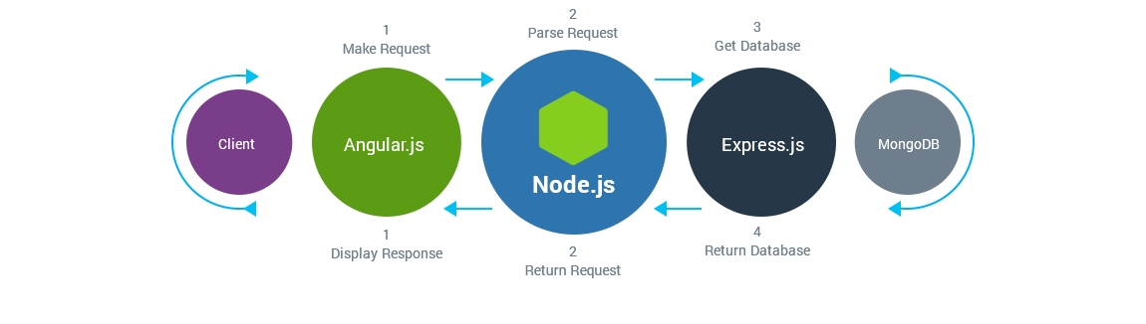
Technologies Used

Slide 6
Features Overview

Slide 7
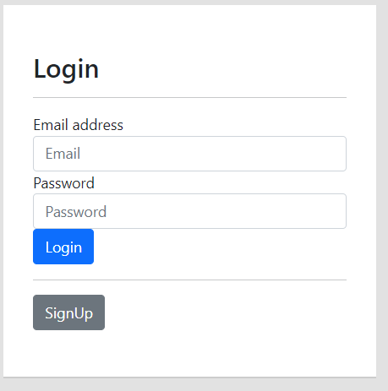
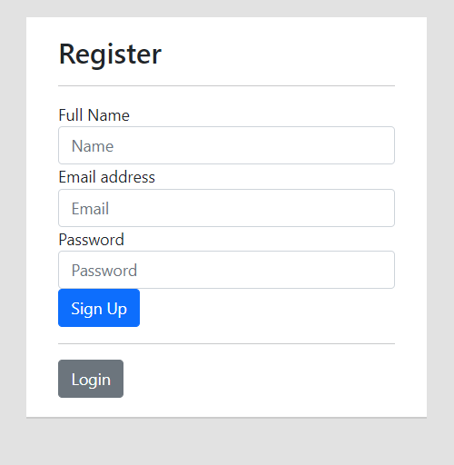
Authentication For Users And Admin
Nobel Laundry’s Laundry Management Systems Provides Its Providing Login And Registration For User to Handle Their Profiles and Orders

Slide 8
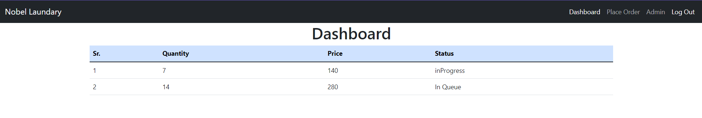
Specific Dashboard For Customers
Provides Dashboard For Customers To Keep Updated About Their Orders And Also Can Place New Orders

Slide 9
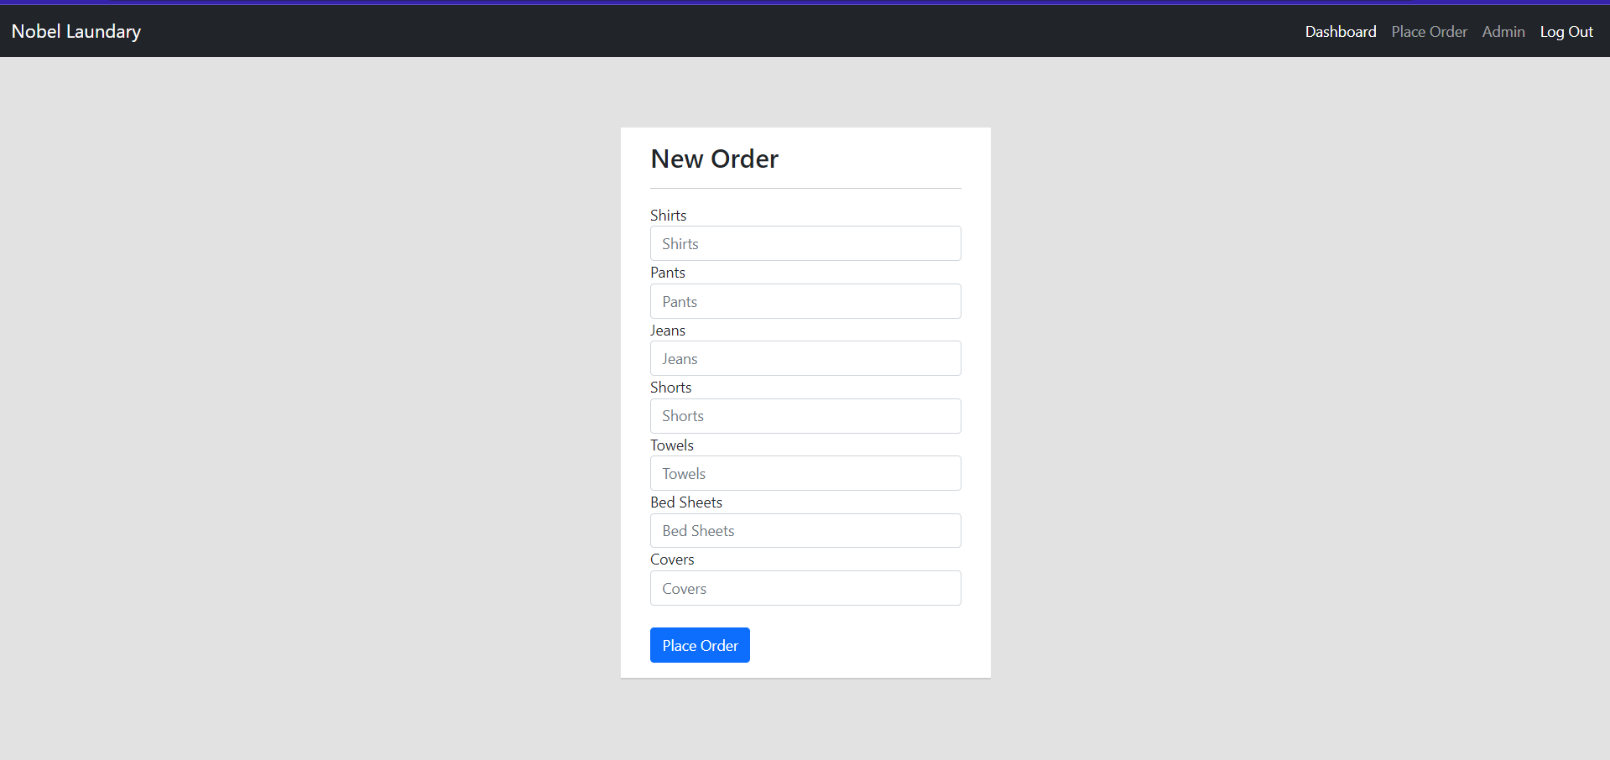
Placing New Order

Slide 10
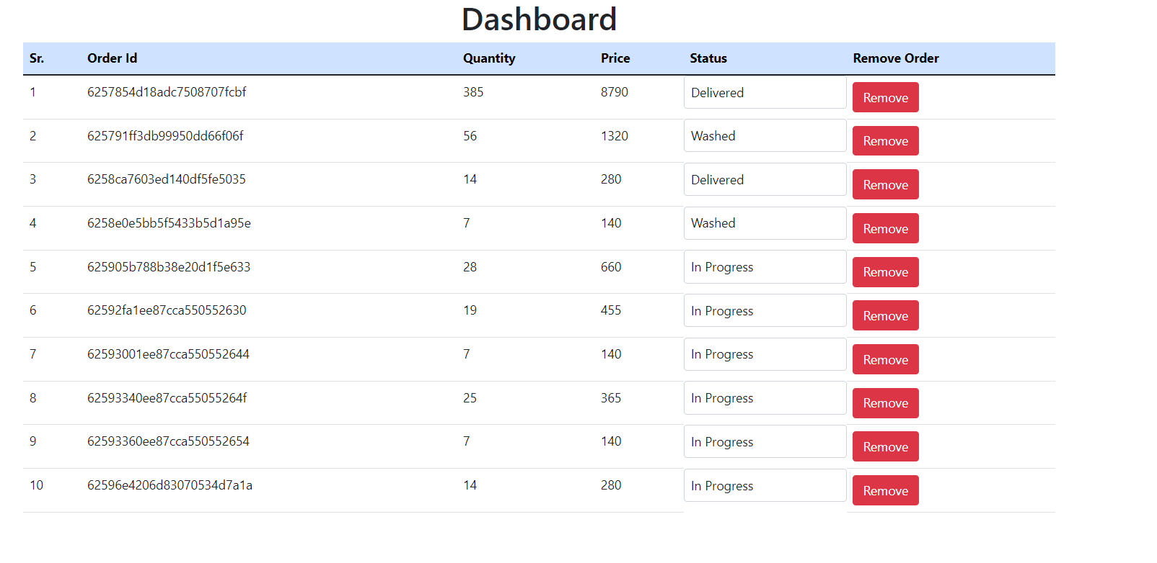
Dashboard For Admin
Provides Dashboard For Owner To Handle The Orders From Customers

Slide 11
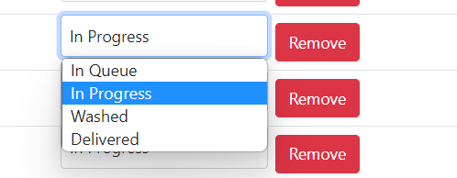
Dashboard For Admin
Admin Can Change The Status Of Order As Well Can Remove From Order List After Delivery

Slide 12
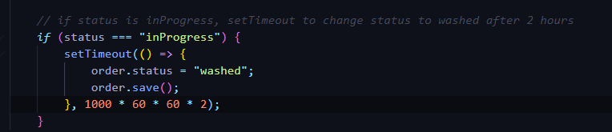
Automation For Orders
Once Admin Processed the Order, It Will Be Updated Automatic After A Certain Amount Of Time

Slide 13
Security

Slide 14
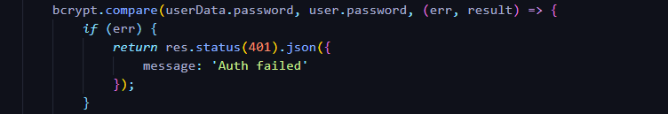
Using JWT Tokens
We Are Using JWT(JSON Web Tokens) For User Authentication And Authorization.

Slide 15
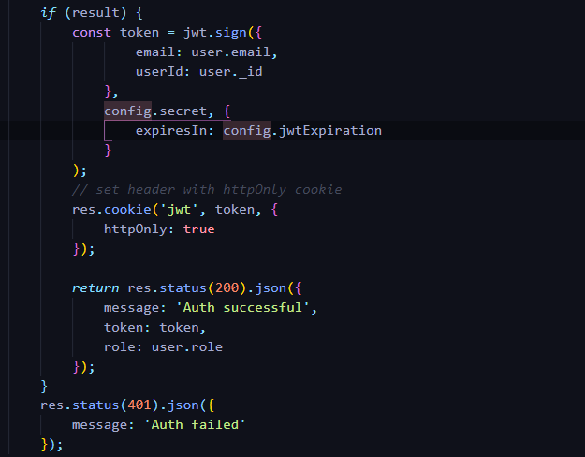

Slide 16
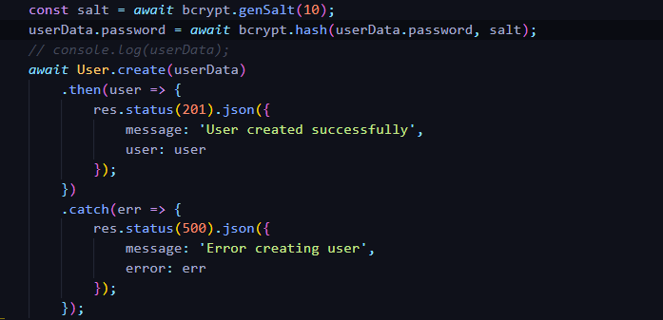
Storing Password In Hashed Form
We Are Storing Passwords In Hashed Format At The Time Of Registration, Instead Of Plain Text.

Slide 17
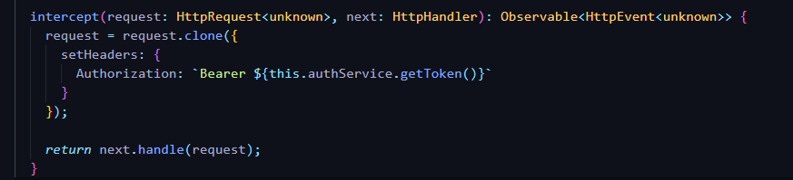
Handling REST API Calls With Auth Header
Using An HTTP Interceptor for Setting An Authorization Header With Every API Call And Validating Token On Backend With A Middleware.

Slide 18
Route Guards For Routes
Used Guards To Protect A Route

Slide 19
Security
Concerns
And
Handling Them
Currently, Using sessionStorage To Store Tokens
To Handle This, We Will Be Setting httpOnly Header With Auth Token

Slide 20
Future
Developments
Better User Experience For Customers
More Secured System
Automation For More Tasks For Admin
New Features To Customers To Make Experience Smooth
Providing Payment System

Slide 21
Thank You
Rajesh Kumar
irajeshberwal@gmail.com
+91-79760233280
Application Link:
https://lms-app-web.web.app

